Slide 1

Minnesota Interstate Traffic Volume
In depth analysis of traffic patterns in interstate highway to make important infrastructure decisions.

Slide 2
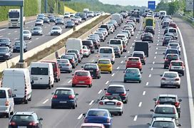

Traffic Congestion keep rising
Becoming a great challenge

Slide 3
Analyzing the data
Viewing the monthly traffic pattern helps to identify the potential trend by months.
Monthly Volume
Weather
Identify the impact of weather on traffic volume.
Volume of vehicle on road substantially increase during holidays.
Holiday

Slide 4
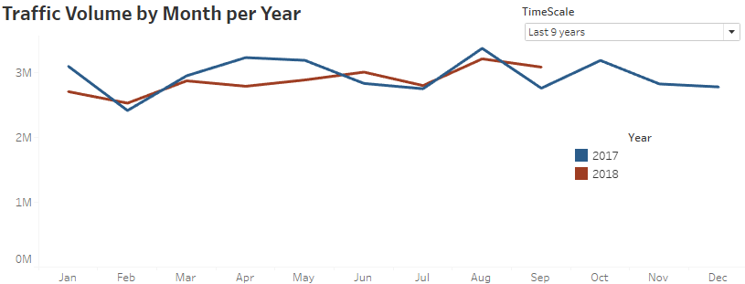
Monthly Traffic Volume
August
Highest traffic
Peak travel season ends as it’s the end of summer
February
Lowest traffic due to winter
Best suitable for construction
April
Significant decrease in 2018

Slide 5

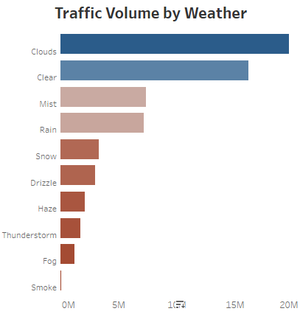


Weather
Highest traffic when weather is clear or cloudy.
Lowest traffic when the visibility is low.
Precipitation has a significant impact on traffic.
What should we do to address the traffic on rainy days?

Slide 6
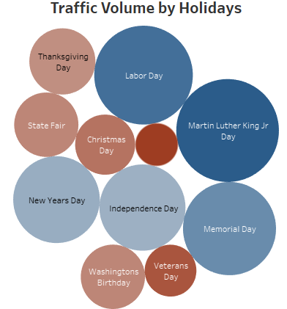
Holiday Travel
January
High traffic on New Year and Martin Luther King Jr Day during January.
May
Labor day and Memorial day contribute to high traffic in May.
Most holidays have little impact on total traffic volume.

Slide 7
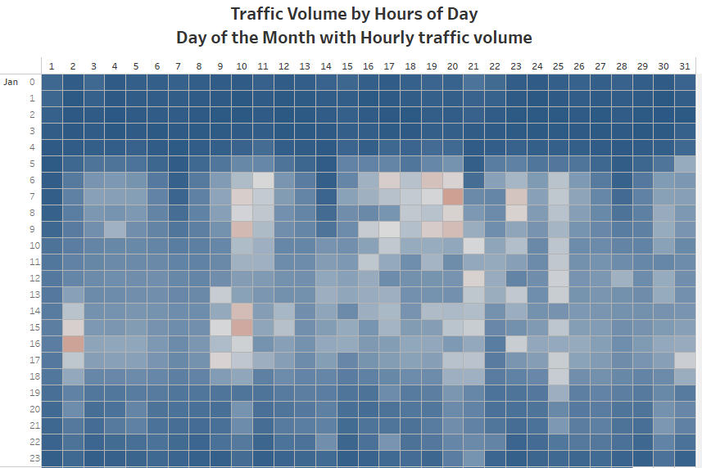
Hourly Traffic
Patterns are reflected during the busiest travel times: rush hours to and from work.
A day with a holiday does not have a significantly higher or lower traffic volume throughout the day.
Holidays do not add impact on hourly traffic volume.

Slide 8
More questions?
Thank You

